Slide 1
Progress Meeting 24/01/24
Literature Study Feedback
3-Dof Model Simulations
3-Dof Numerical Trim
Github Repo

Slide 2
Literature Study Feedback
Discuss potential grade?
Discuss points to be rewritten/revised

Slide 3



3-Dof Trim
Newton-Rhapson Trim algorithm
Simplified inflow to be uniform for both upper and rotor after encountering numerical issues, to be updated later (if necessary, doesn’t add much fidelity)
State vector f → udot, wdot, qdot, lambda_0_u_dot
Trim vector x → theta_0_u, theta_0_l, theta_c, lambda_0_u

Slide 4
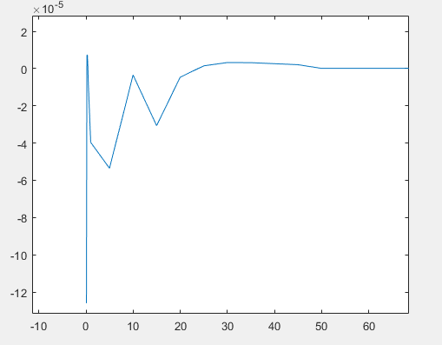
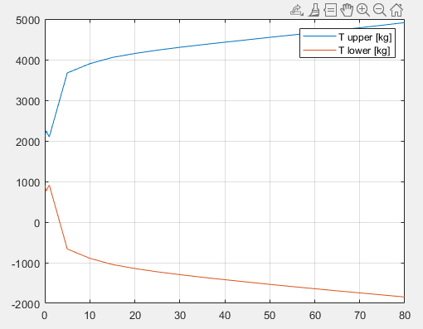
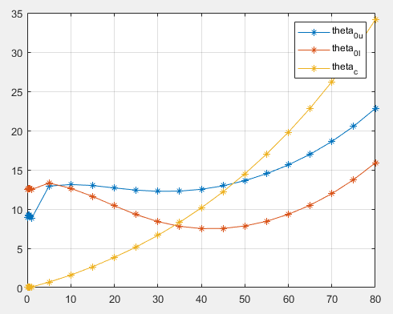
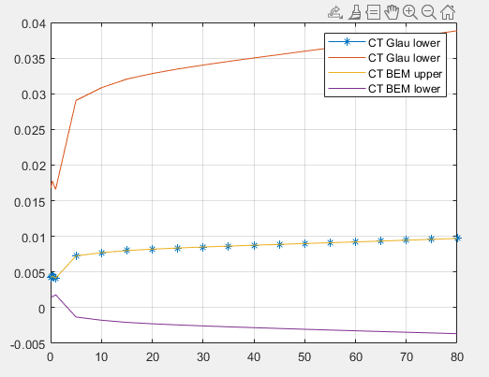
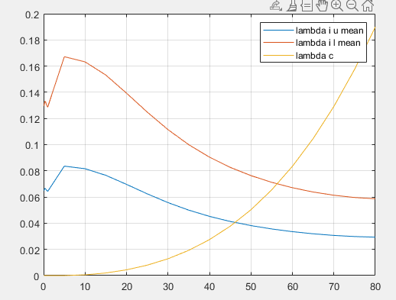
3-Dof Trim
After many iterations and debugging
Problem at low speed inflow, and a divergence of C_T_BEM_l

Slide 5

3-Dof Trim
Equation for C_T_BEM: → in control plane
I tried to make a 5th trim target and state for quasi-dynamic inflow of lower rotor, it did converge, but not to the Glauert values
Perhaps inflow lambda_i_u_mean and lambda_0_u (trim var] are not properly integrated in the software → check
Maybe use actual BET [according to memorandum]
Trim variables

Slide 6
3dof Model Simulations
Quasi-dynamic inflow
Coaxial rotor
Uniform inflow upper rotor
Linear inflow lower rotor
Interference effects
Complete ‘boost’ (*1) of upper on lower
Numerical issues with the linear pre-allocation of interference factor w.r.t advance ratio, but the *1 is in line with literature (Ferguson, Qiu, Berger)
No effect of lower on upper
No pusher propeller or stabilator/elevator + hor. stabilizer yet

Slide 7
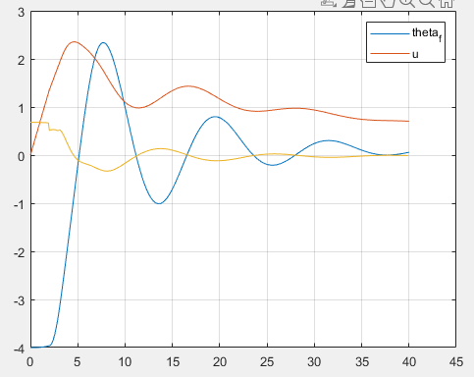
3dof Model Simulations
Again abnormalities at initial udot

Slide 8
Github Repo
Made today
Access via e-mail invite

